Slide 1

Presented by
Forough Zarei
Anil Kumar Sriram
Atefeh Safarakhah

Slide 2

Idea
Making interactive communication between professors and students
Apportunity to choose thesis topics regarding to students academic background
Increasing productivity of thesis progress

Slide 3
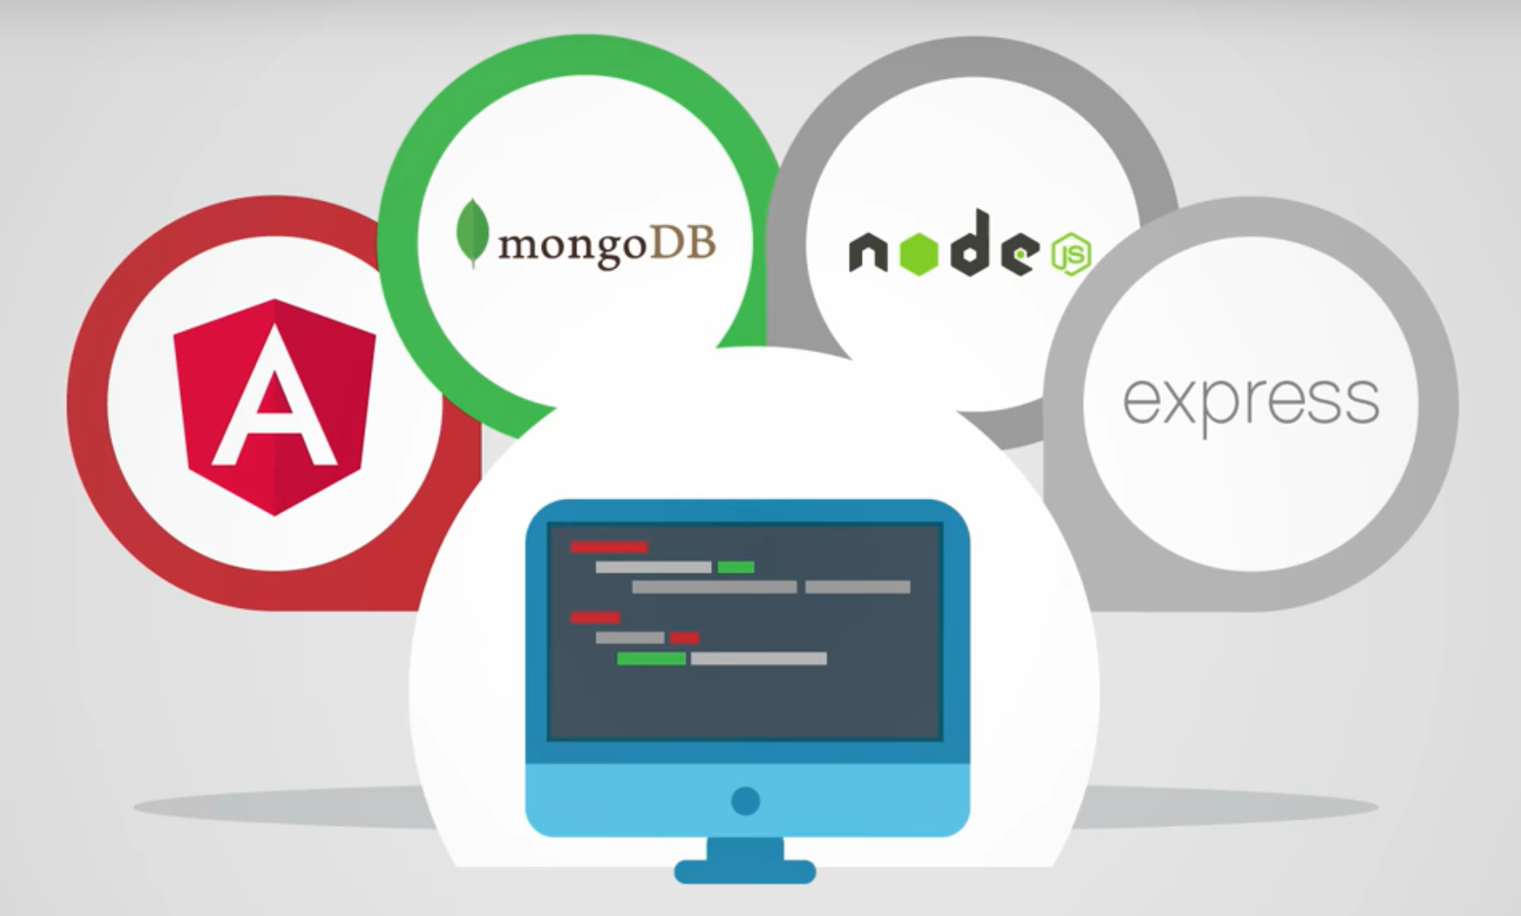
technologies used

Slide 4
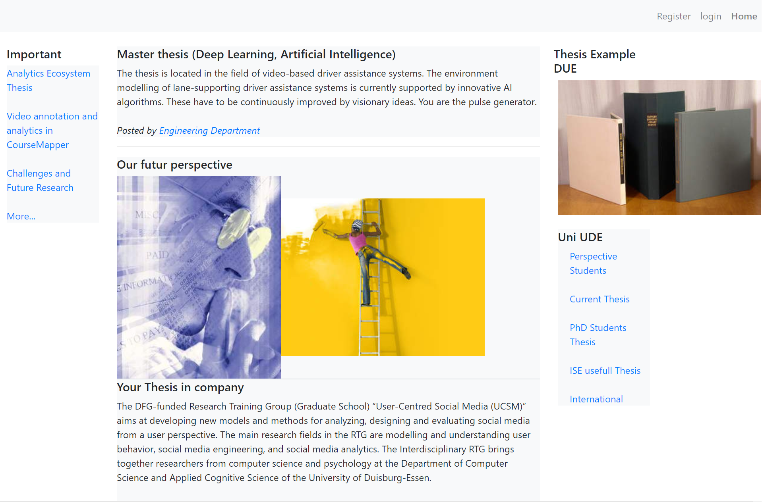
Home

Slide 5
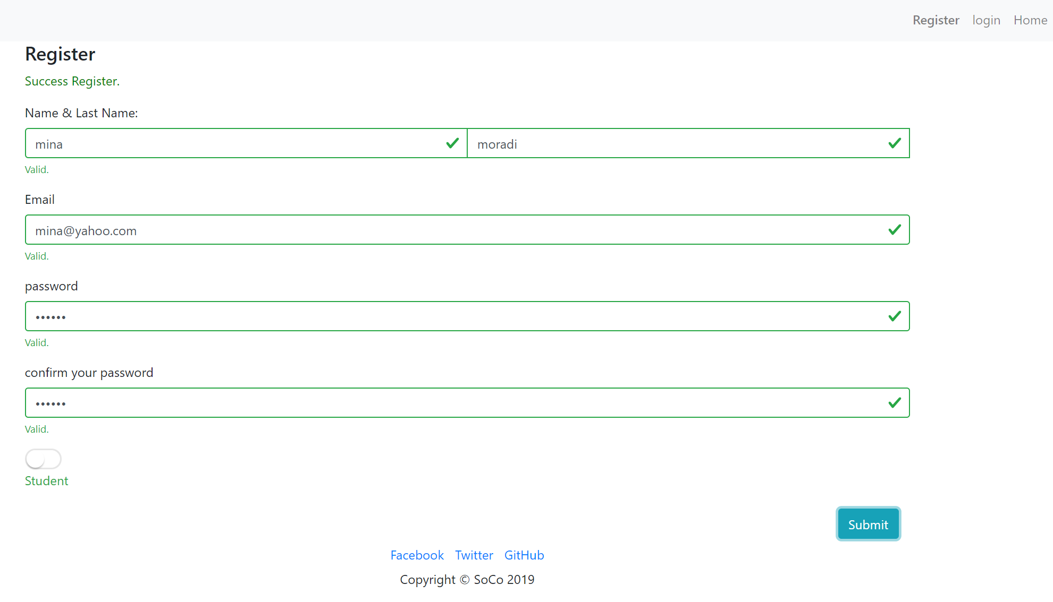
Register

Slide 6
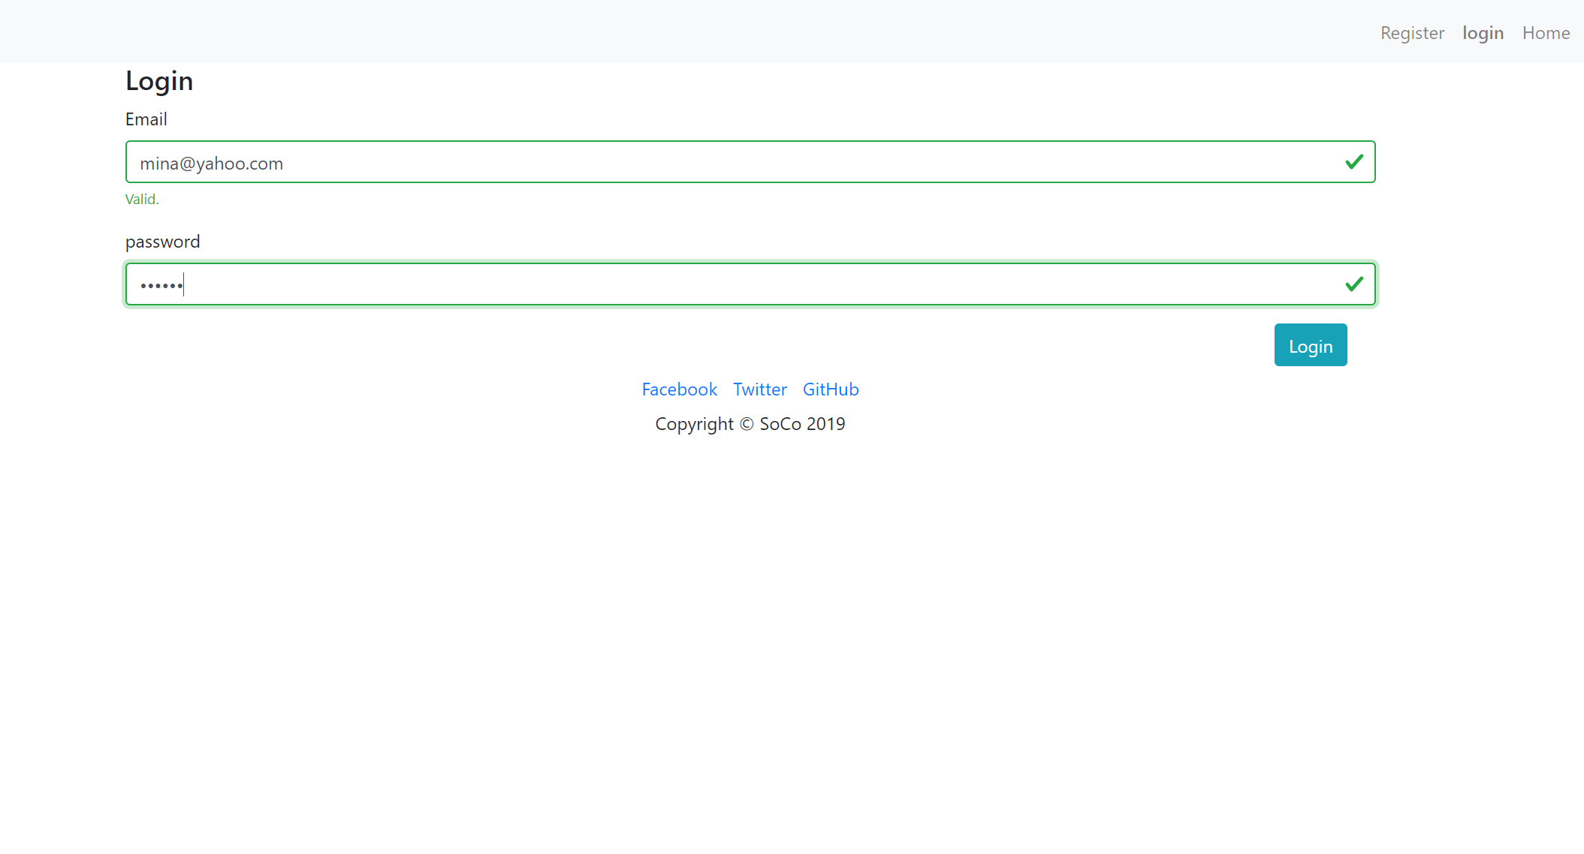
Login

Slide 7
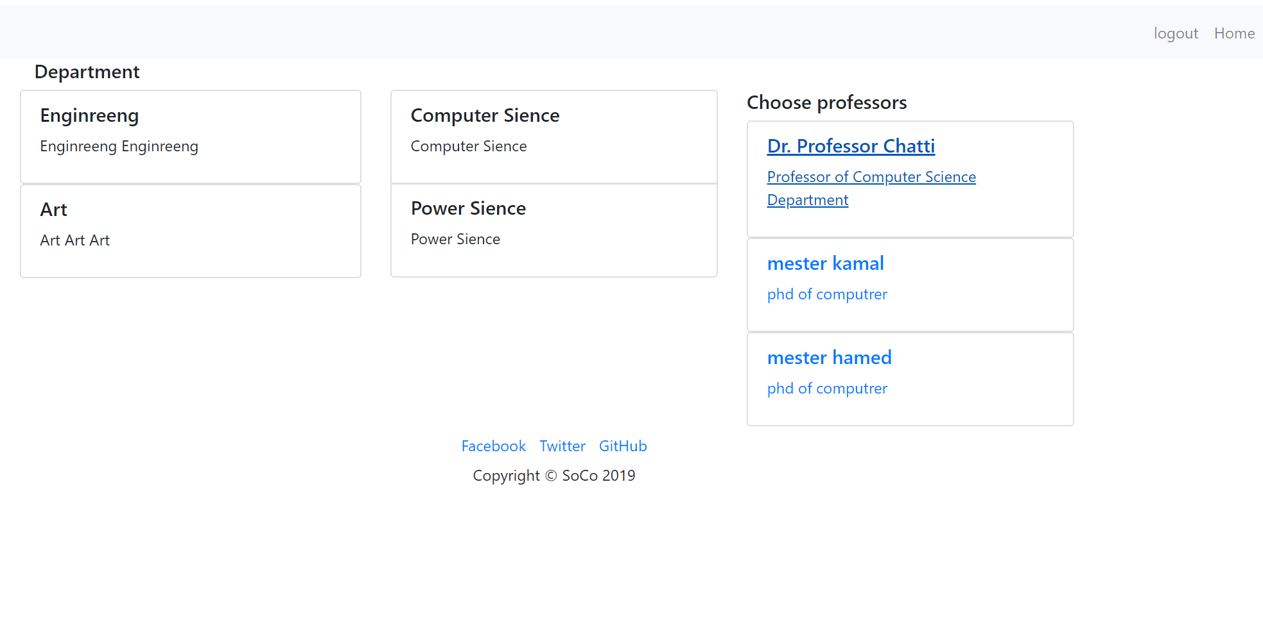
Department

Slide 8
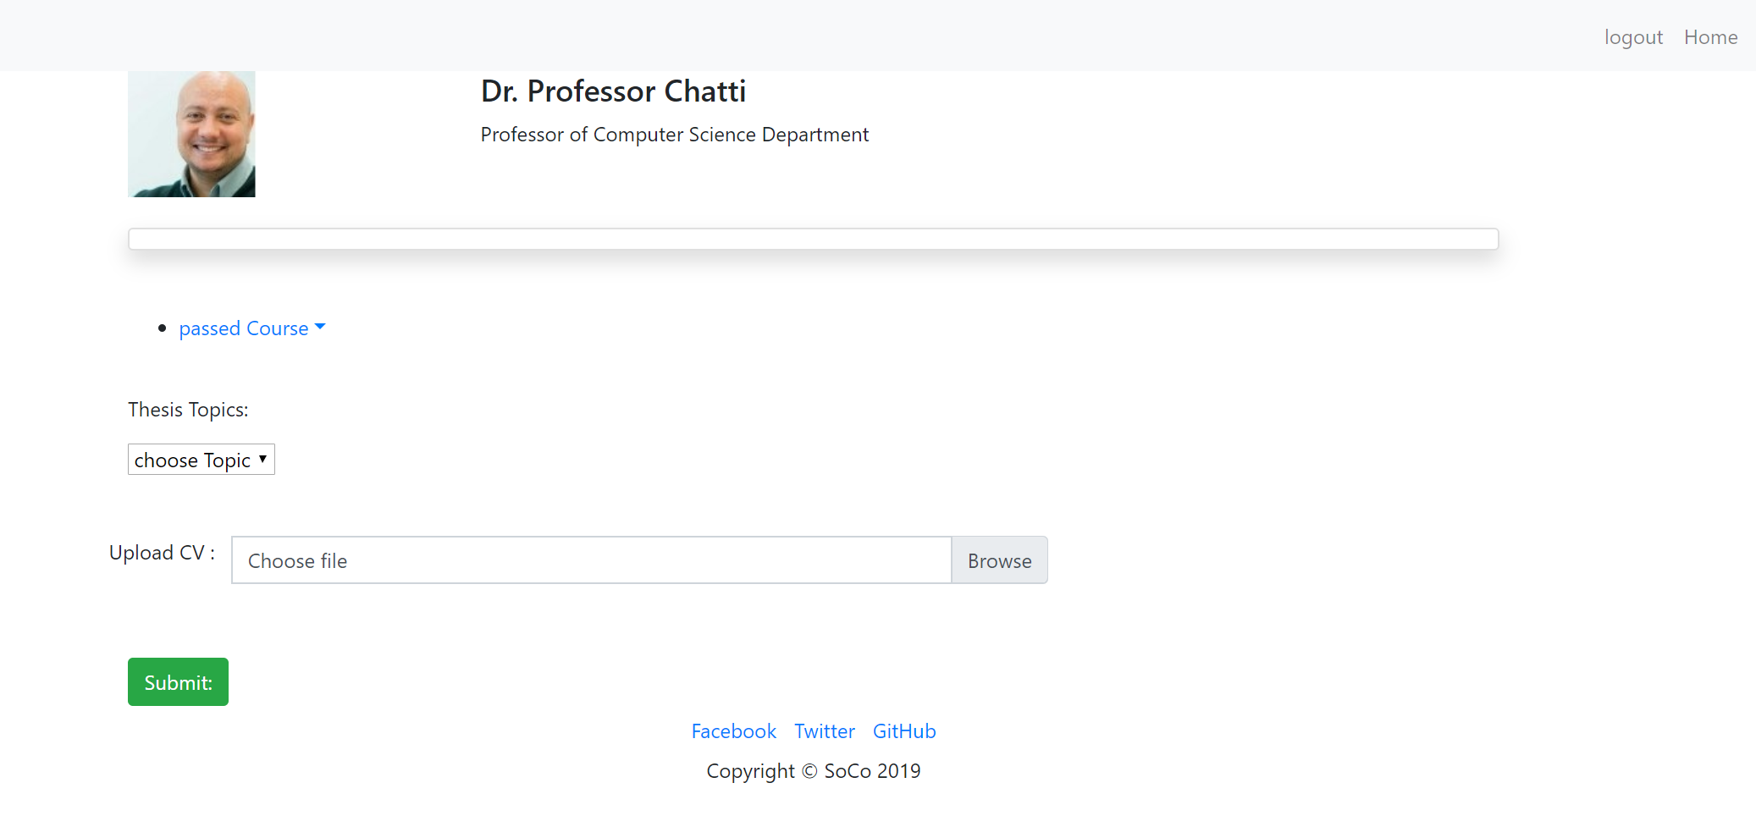
Student page

Slide 9
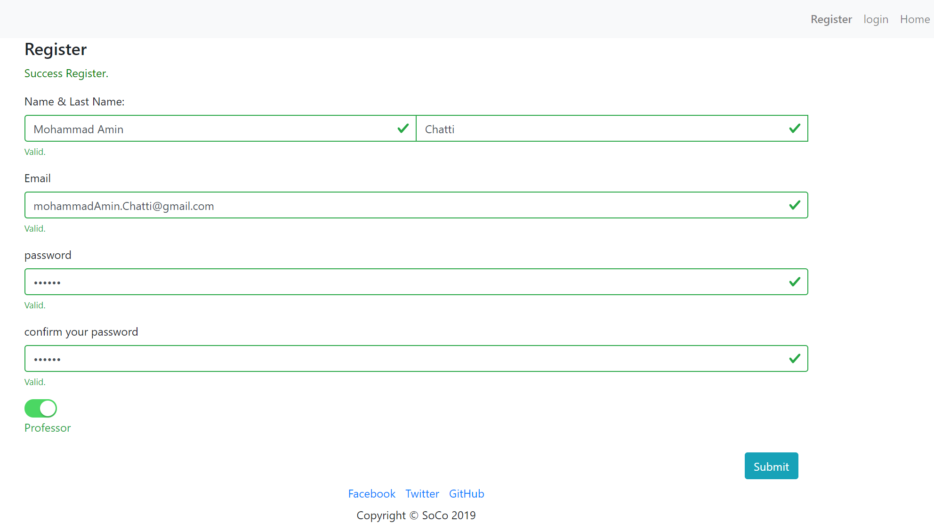
Professor registeration

Slide 10
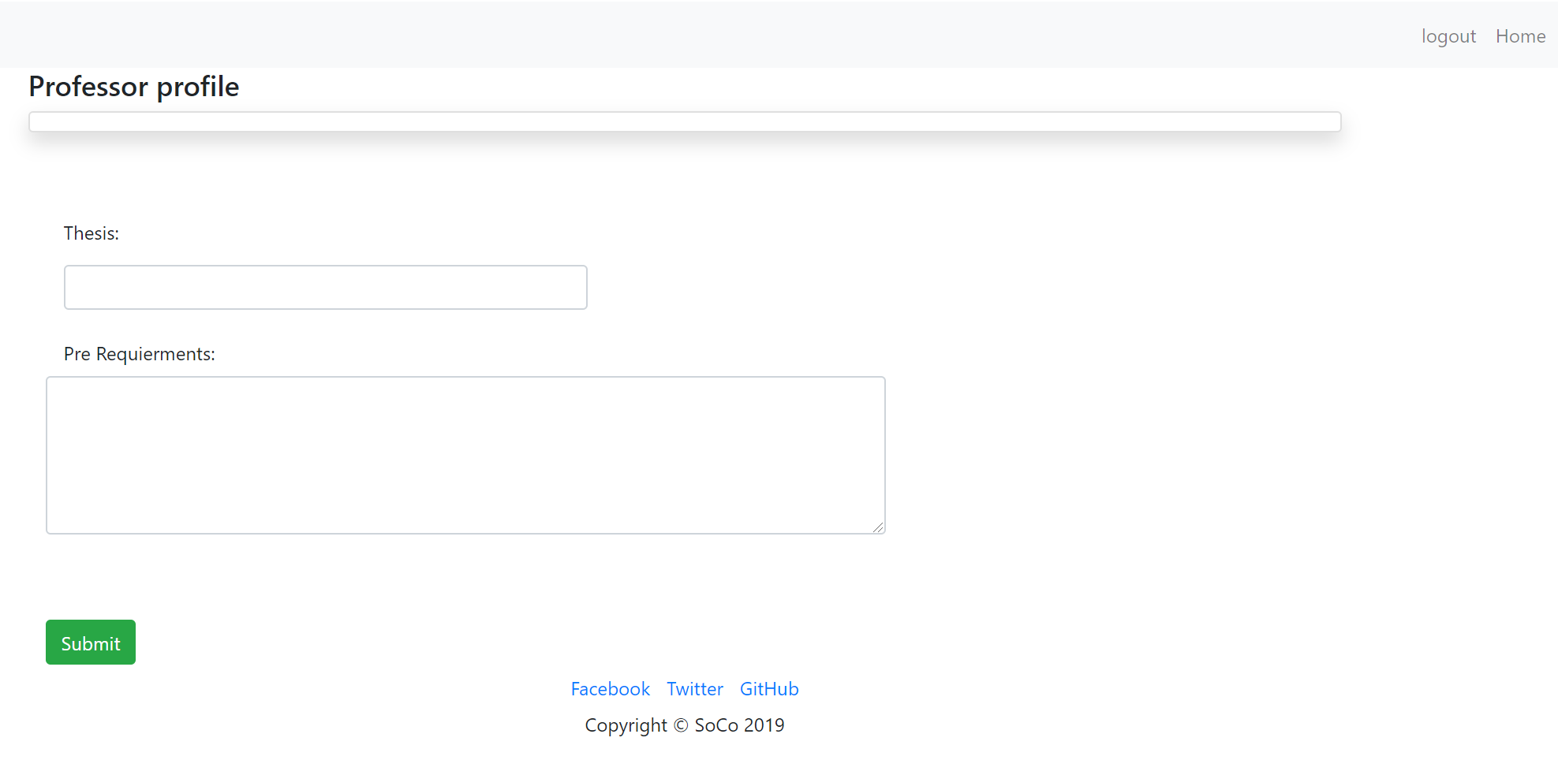
Professor profile

Slide 11
Links
GitHub :
    https://github.com/beinganis/AwtProject2019
Youtube :
    https://www.youtube.com/watch?v=7aTcxYJ10C4
Heroku :
    https://awtprojectude2019.herokuapp.com

